Slide 1
Dealing with gene models from 50 reference genomes
A Progress Report from MaizeGDB
Lisa Harper, June 2, 2020

Slide 2
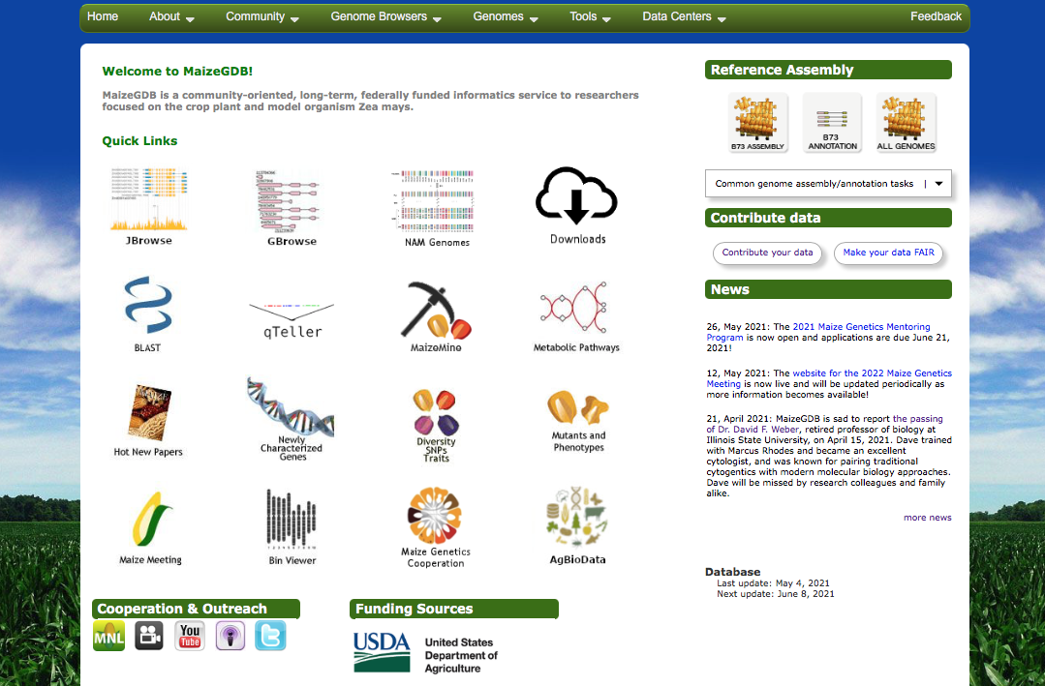
How did we get so many genomes?

Slide 3
How did we get so many genomes?
We advertise information on how to contribute all types of data, including whole genome assemblies, and how to make data FAIR.
In order for a genome to be “hosted” at MaizeGDB, we require:
1. Genome assembly must be submitted to NCBI Genbank or EBI ENA
Must use our genome nomenclature
Must complete our metatdata template

Slide 4
When we “Host” a genome assembly, we
Provide metadata more complete than NCBI
Provide a JBrowse instance, with re-mapped data
Provide BLAST targets
Add the genome to a Pan-genome calculation

Slide 5
About the genomes
We DO still have ONE genome that we spend more resources on: B73.
We still call this the “reference” or “representative” assembly.
However, most of the other genome assemblies we support are reference quality.

Slide 6
Finding the genomes

Slide 7
Quick links to JBrowse (newer genomes) and GBrowse (older genomes)

Slide 8
Information on the Set of 26 genomes of the “Nested Association Mapping” (NAM) founder parents.
These were all sequenced, assembled and annotated by one group using the same wet lab and in silico pipelines. They are directly comparable

Slide 9
Home Page
Because it is often hard to find all genome/assembly/annotation etc. files, we have standardized the file names and offer all data as downloads, here and on our CyVerse page.

Slide 10
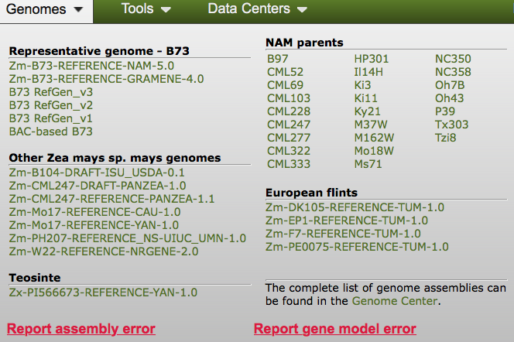
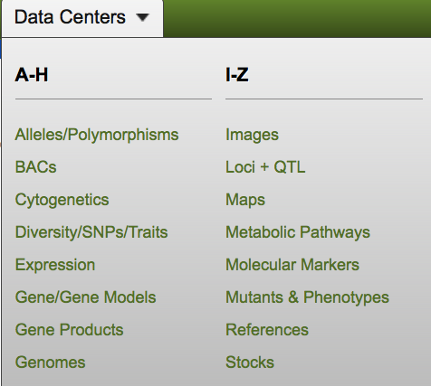
Info on All Genomes
The Genome Information Data center can be found multiple ways

Slide 11
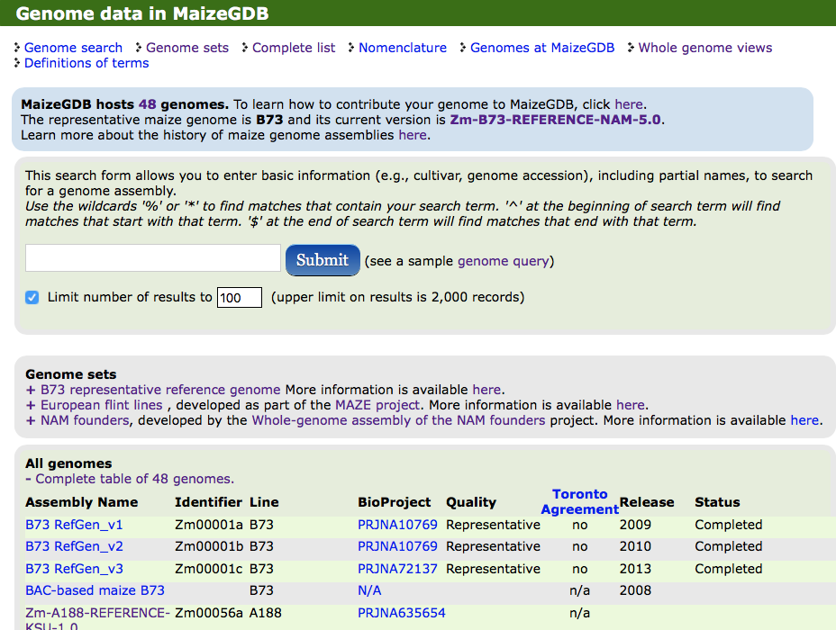
Genome Data Center

Slide 12
Individual Genome Page
Note the tabs

Slide 13
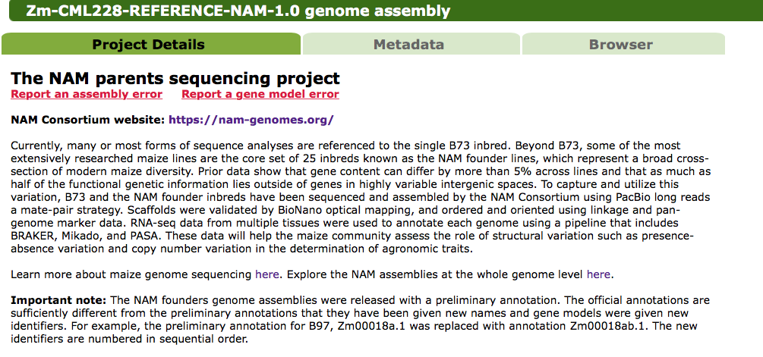
Individual Genome Page

Slide 14
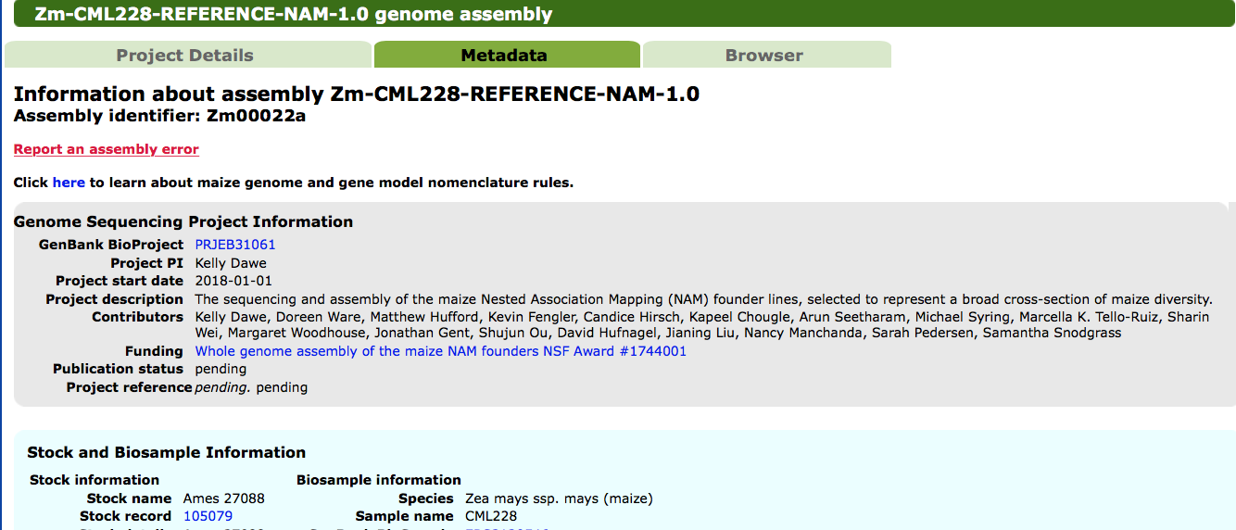
Individual Genome Page
Long page
Scroll Down

Slide 15
So, now we have 50 genomes.
That means we have up to 50 slightly different gene models for each gene.
These are technically alleles, but we treat them a little differently

Slide 16
First 100 years of maize genetics:
several thousand genes identified, many defined by mutant phenotype, some found by reverse genetics (by sequence homology).
We have a lot of “genetic” and functional information on these genes (Genetic map positions, alleles, phenotypes, stocks, etc)
Not all genes are yet connected to a gene model (about 10,000 today)

Slide 17
2009: First maize sequence assembly
Genetic Information
On a single gene
Gene Model B73_v1
One gene model- per gene
About 10,000
Gene records from the first 100 years of maize genetics
About 100,000 gene-model records for one genome

Slide 18
2017
Genetic Information
Gene Model From B73_v1
Gene Model From B73_v2
Gene Model From B73_v3
Gene Model From B73_v4
Still 10,000
Gene records
About 40,000-100,000 gene-model records for one genome
X 4 = 400,000

Slide 19
2021 ~50 genomes!
Genetic Information
Gene Model From B73_v3
Gene Model From B73_v4
Gene Model From B73_v5
Gene Model From Mo17
Gene Model From W22
Gene Model From W23
Gene Model From CML103
Gene Model From CML228
Gene Model From DK105
Gene Model From Ep1
Gene Model From F7
Gene Model From Ki3
Gene Model From HP301
Gene Model From NC358
Gene Model From P39
Gene Model From PH207
Gene Model From Ab10
Still 10,000
Gene records
About 100,000 gene-model records for one genome
X 50 = 5,000,000 gene models

Slide 20
How we deal with this?
Maintain the 10,000 manually connected gene- gene model relationships
Extend this to gene models from other lines
Some genes may not have syntelogs (biologically or by mistake) in all lines
Lots of ”genome biology” unknowns

Slide 21
And more issues- getting information on one gene consolidated in one place
Gene lg1
Gene Model From B73_v5
Gene Model From Mo17
Gene Model From W22
Gene Model From W23
Gene Model From CML103
Ontolgy anotation
Expression Data from RNAseq
New function identified in wet lab

Slide 22
Current Approach

Slide 23
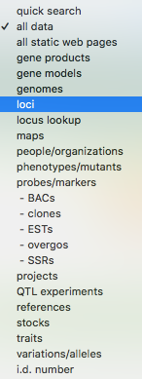
Look at one gene

Slide 24
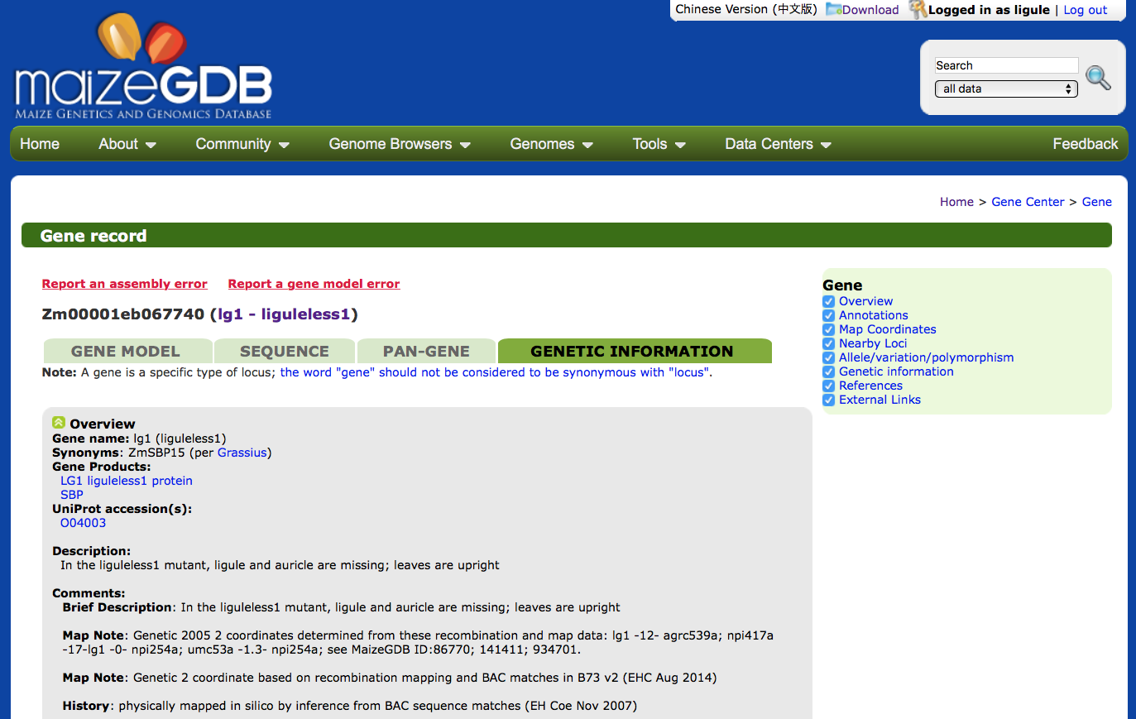
Gene Pages
Individual Gene Record
Scroll Down

Slide 25
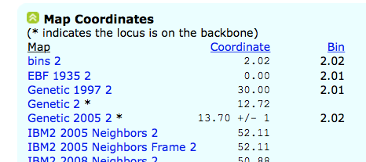
Scroll Down

Slide 26
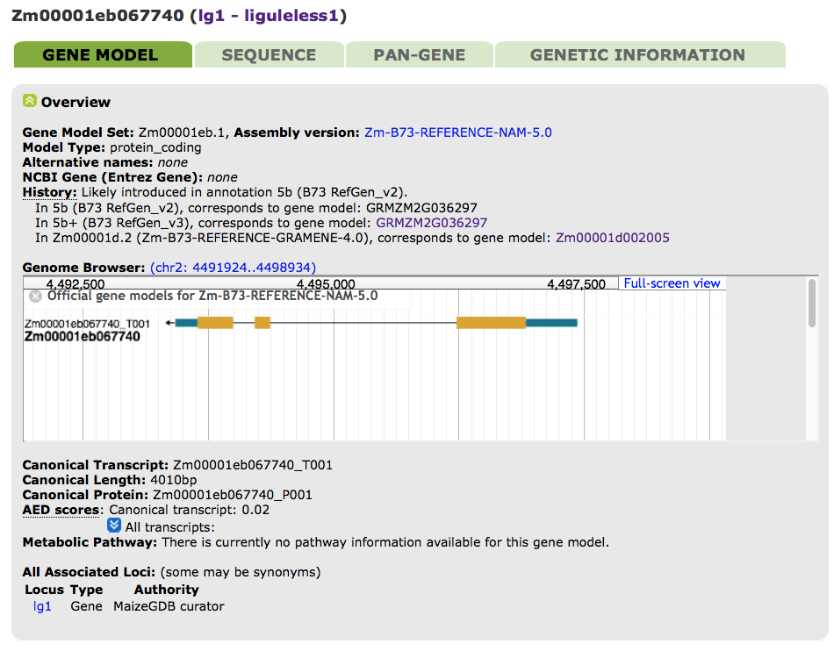

Slide 27
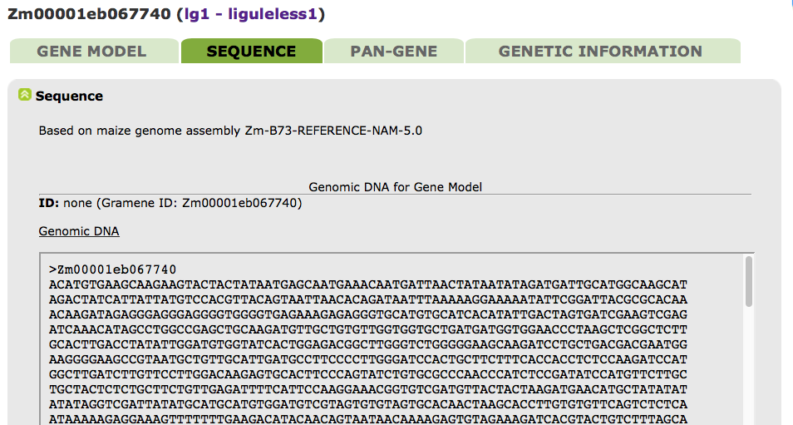

Slide 28
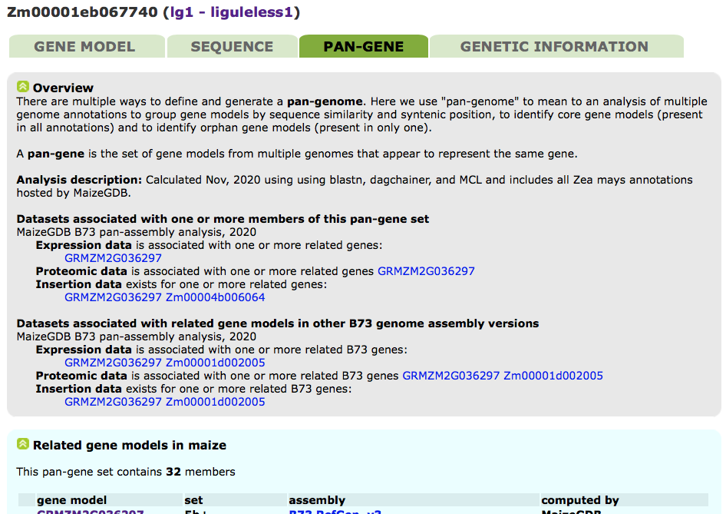
Gene Pages
The NEW “PAN-GENE” tab lists the gene models from all sequence assemblies that are likely the same gene, based on homology and synteny.

Slide 29
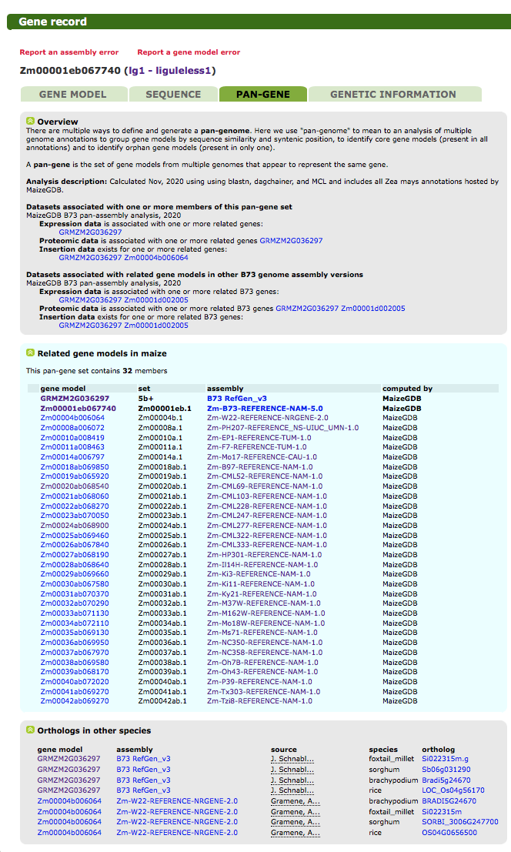
Each “Pan-genome” calculation will be named using a standard nomenclature (MaizeGDB Pan-Genome + Date), and have associated metadata which will include methods and genome assemblies used.

Slide 30
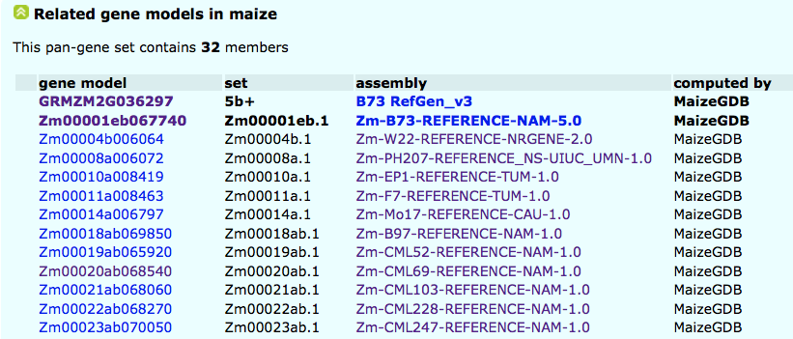

Slide 33
Current Approach
Gene Model From B73_v3 B73_v3 sequence lg1 Pan-gene Genetic Info on lg1
Gene Model From B73_v4 B73_v4 sequence
Gene Model From B73_v5 B73_v5 sequence
Gene Model From Mo17 Mo17 sequence
Gene Model From W22 W22 sequence
Gene Model From W23 W23 sequence
Gene Model From CML103 CML103 sequence
Gene Model From CML228 CML228 sequence
Gene Model From DK105 DK105 sequence
Gene Model From Ep1 Ep1 sequence
Gene Model From F7 F7 sequence
Gene Model From Ki3 Ki3 sequence
Gene Model From HP301 HP301 sequence
Gene Model From NC358 NC358 sequence
Gene Model From P39 P39 sequence
Gene Model From PH207 PH207 sequence
Gene Model From Ab10 Ab10 sequence
Etc… Etc…

Slide 34
Current Approach
Still lots of unknowns
How are others doing this?
What is useful to our stakeholders?

Slide 36
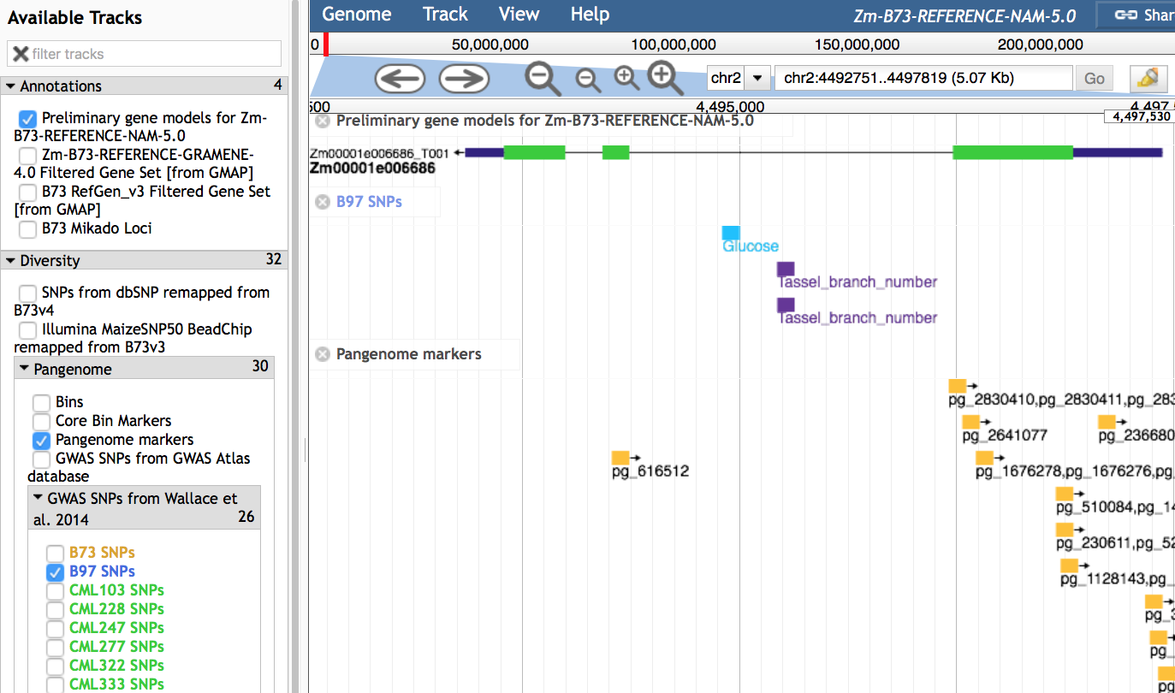
JBrowse

Slide 37
JBrowse JUMP between NAM genomes
ALL the tracks under “Pangenome” allow jumping to the syntentic region in another NAM founder genome

Slide 38
JBrowse JUMP between NAM genomes
For example, click on this SNP from B97 (which is associated with the trait “glucose”)

Slide 39
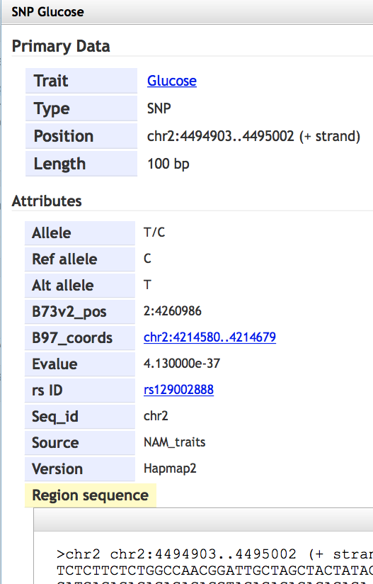
JBrowse
Information about this SNP will pop up
To see this SNP in the B97 (NAM founder) genome,
Click here

Slide 40
JBrowse
Another example
Click on this Pangenome marker

Slide 41
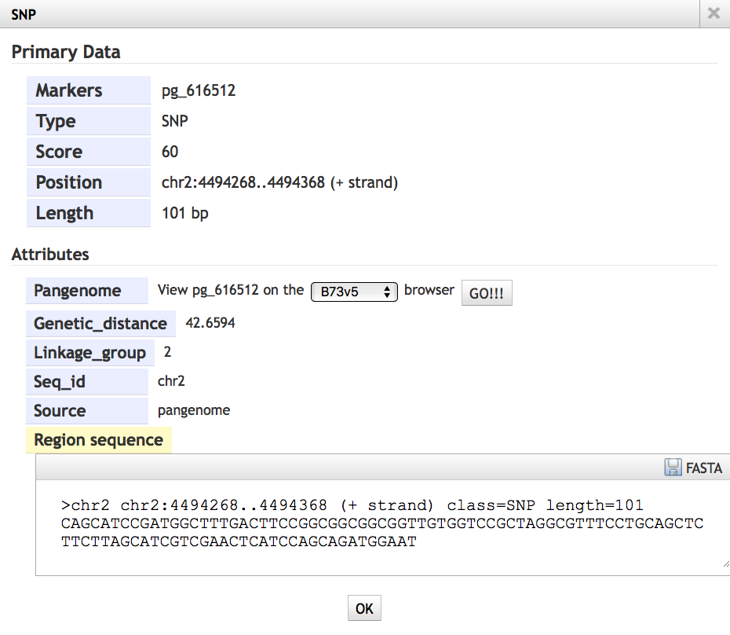
JBrowse
Information will pop up
To see this marker any other NAM founder genome, select from the drop down menu

Slide 42
JBrowse

Slide 43
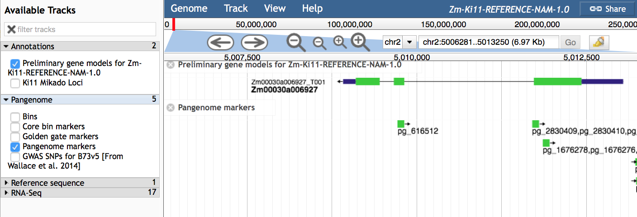
JBrowse
Now we are in the Ki11 genome right at that marker!

